Slide 2
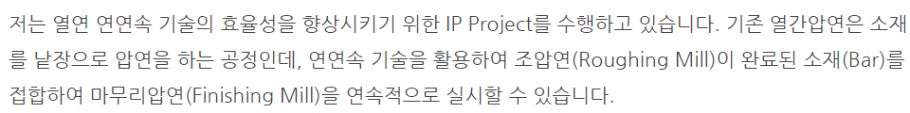
Notes:
https://newsroom.posco.com/kr/2015-%EC%95%8C%EC%95%84%EB%B3%B4job-3%ED%8E%B8-%EC%83%9D%EC%82%B0%EA%B8%B0%EC%88%A0%EC%95%95%EC%97%B0-%EC%97%B4%EC%97%B0%EB%B6%80-%EA%B9%80%ED%98%84%EC%A7%84-%EB%A7%A4%EB%8B%88%EC%A0%80/

Slide 3
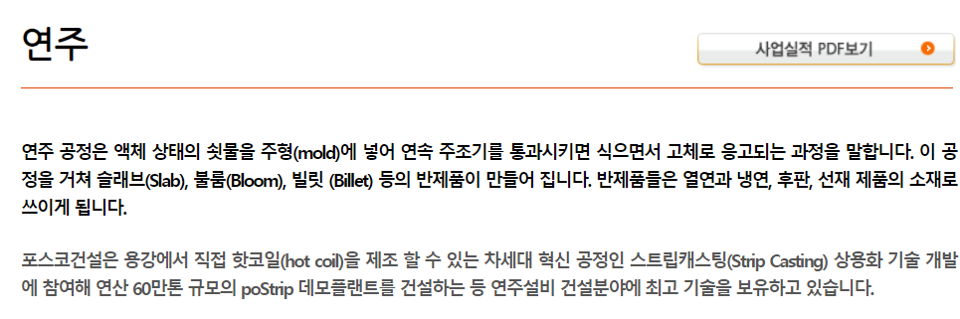
Notes:
https://www.poscoenc.com:446/business/steel_continuous_casting.asp

Slide 4
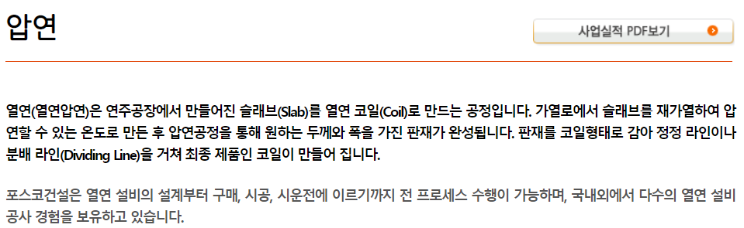
Notes:
https://www.poscoenc.com:446/business/steel_hot_rolling.asp

